Slide 1
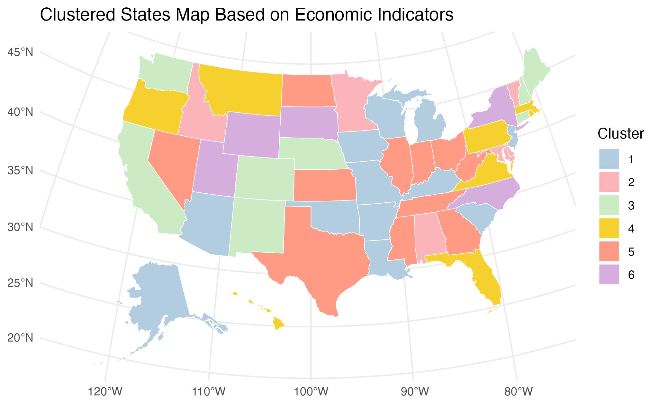
Economic Disparities
Among U.S. States in 2023：
An Analysis of Regional Data
from the Bureau of Economic Analysis
MM.DD.YY
Group 19
Ruisi Ma
Zhenjing Zhou
Dec. 2nd, 2024

Slide 2
Description
Data Source: Regional dataset from BEA - Using BEA’s API and the bea.R package.
Research Question
How do the U.S. States differ in employment density/GDP/PCE/GOS/income?
How do these indicators of economic disparities correlate with each other?
How does geographical proximity associate with economic disparities?
Level of Analysis
State
Key Indicators
SAINC30 Economic Profile (PerCap personal income, Total Employment)
SAGDP1 GDP by State Summary (Real GDP, Gross operating surplus)
SAPCE2 PCE by Major Type of Product (PerCap PCE)
Merged Data (self calculated: Employment PerThousand, PerCap Real GDP, PerCap gross operating surplus)
Eventually, the merged dataset contains 50rows x 22columns.

Slide 3
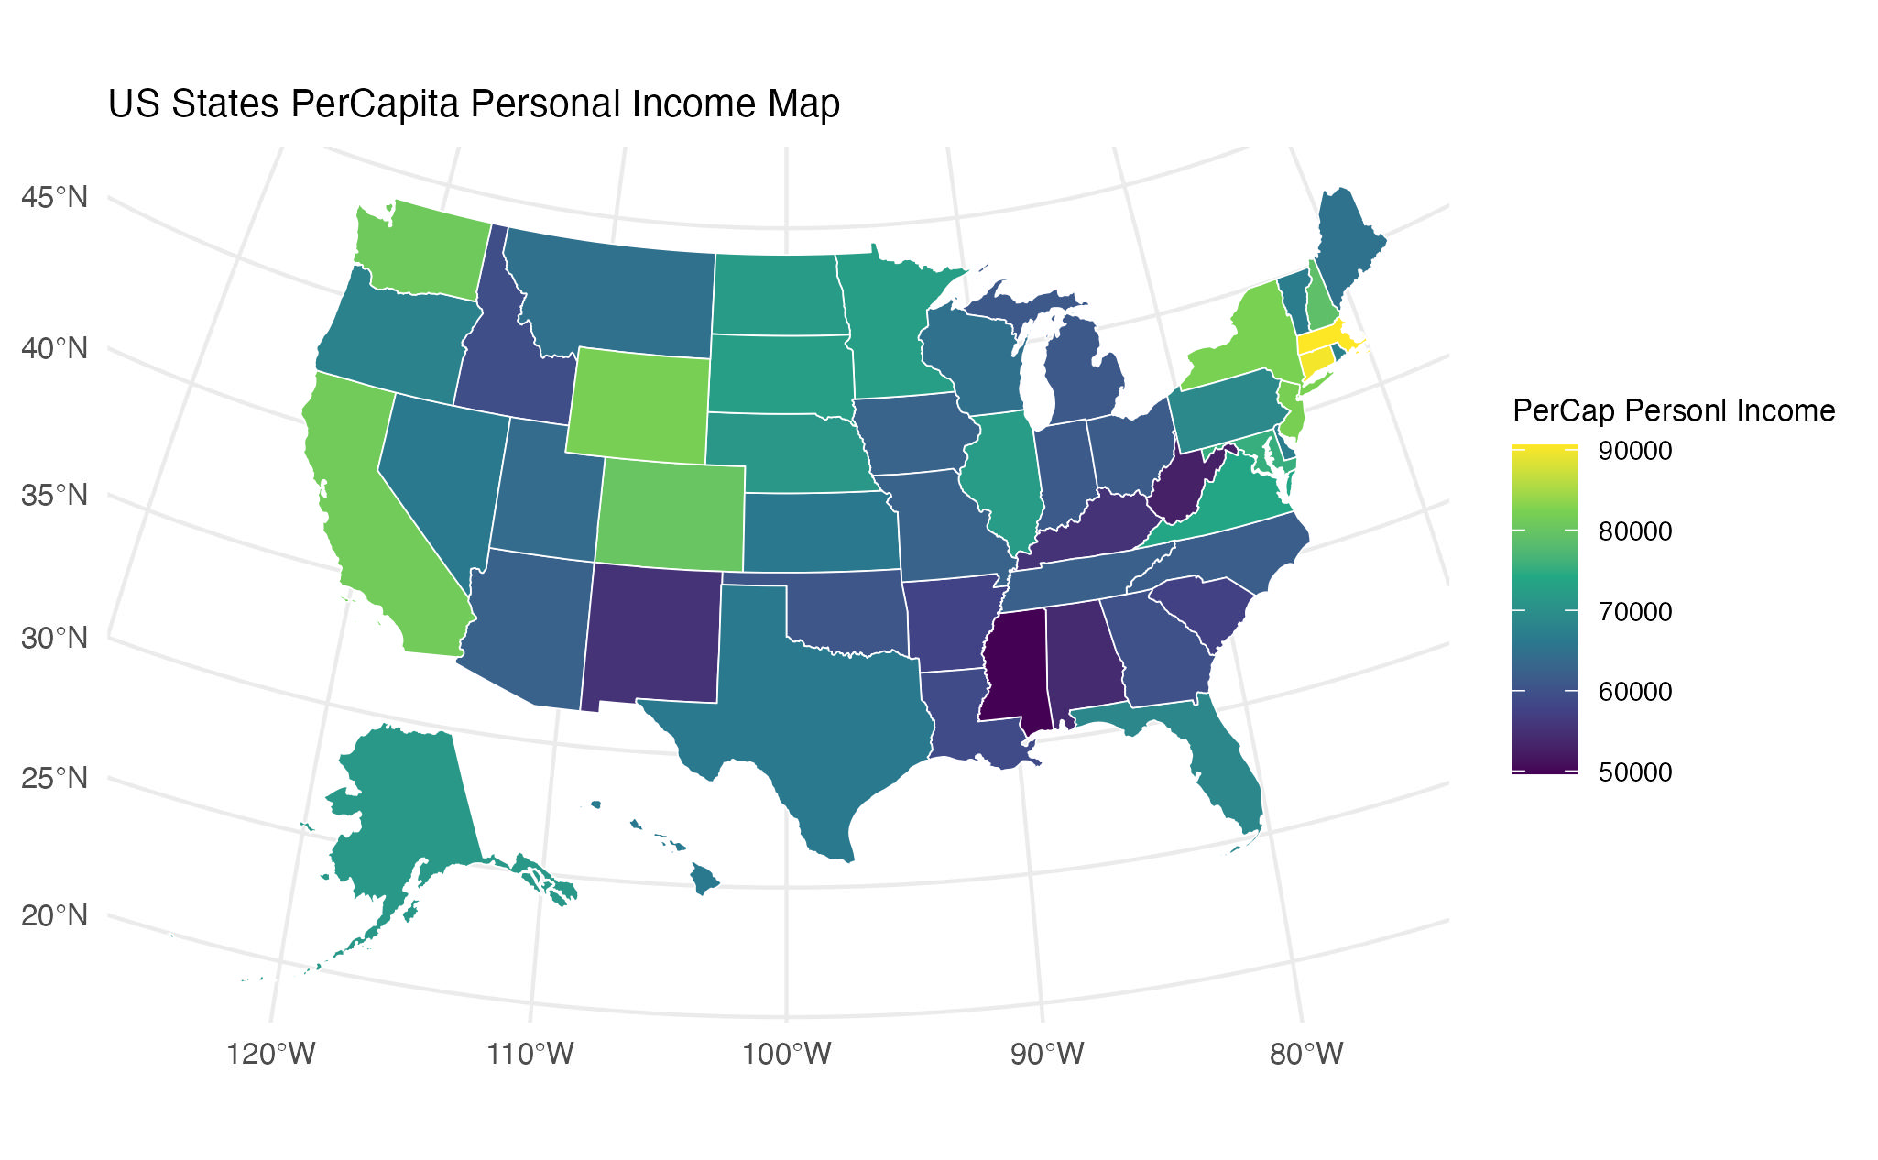
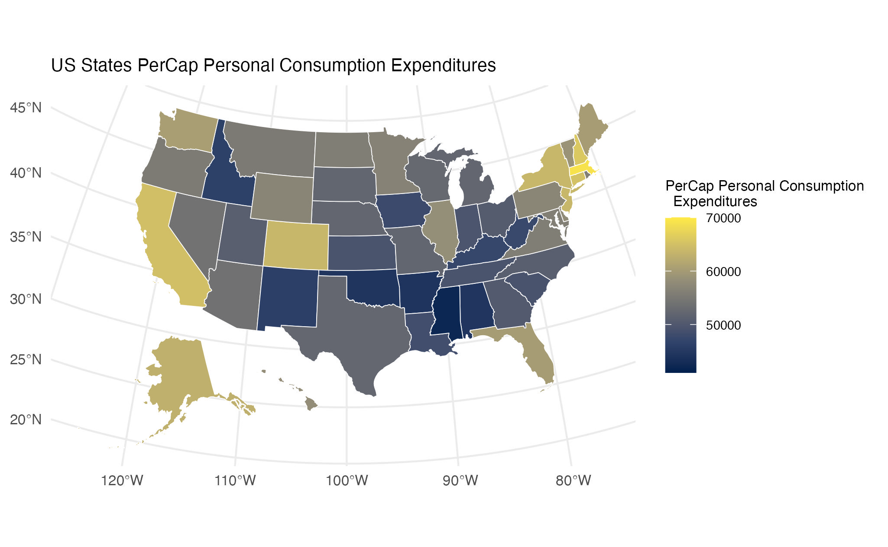
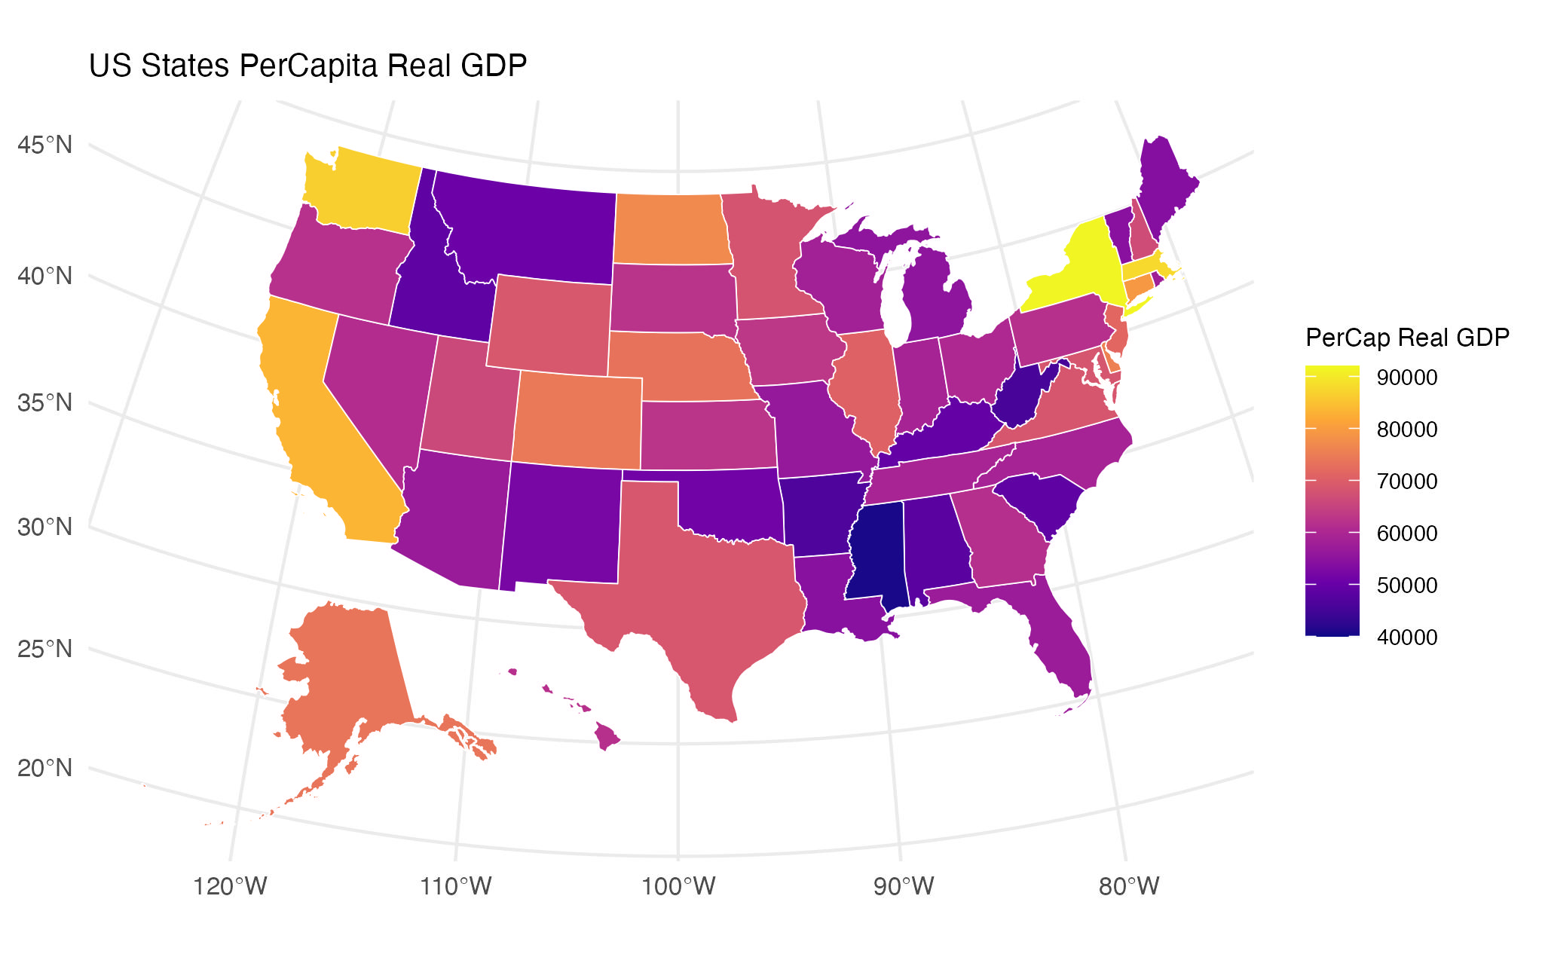
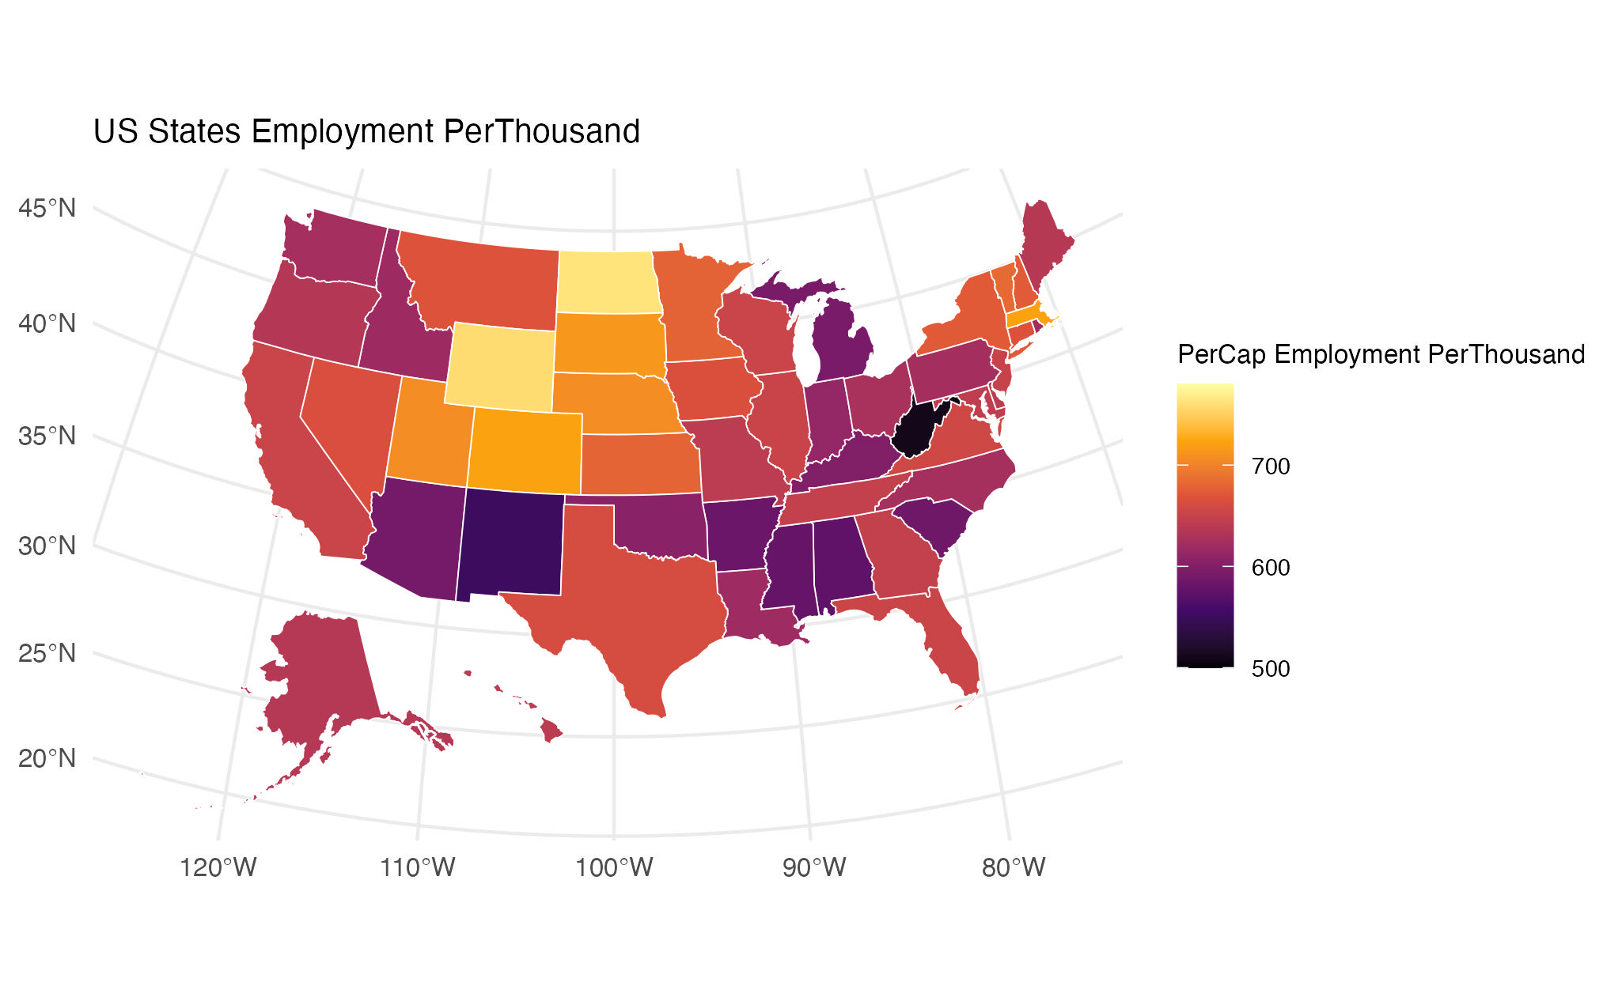
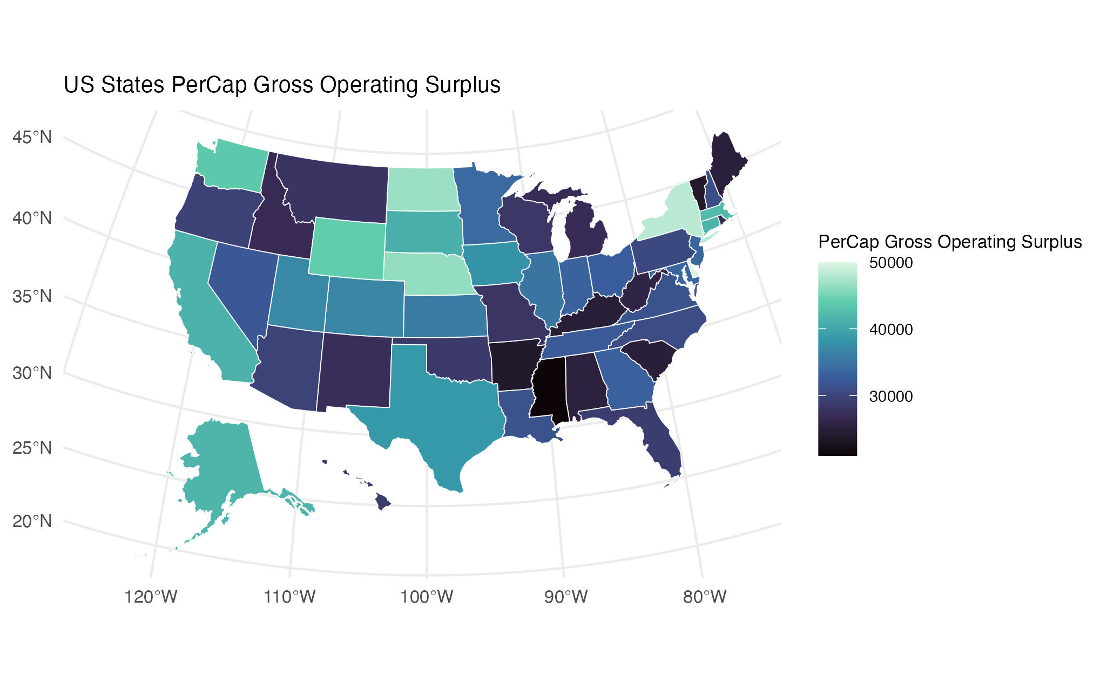
Description – Distribution

Slide 4
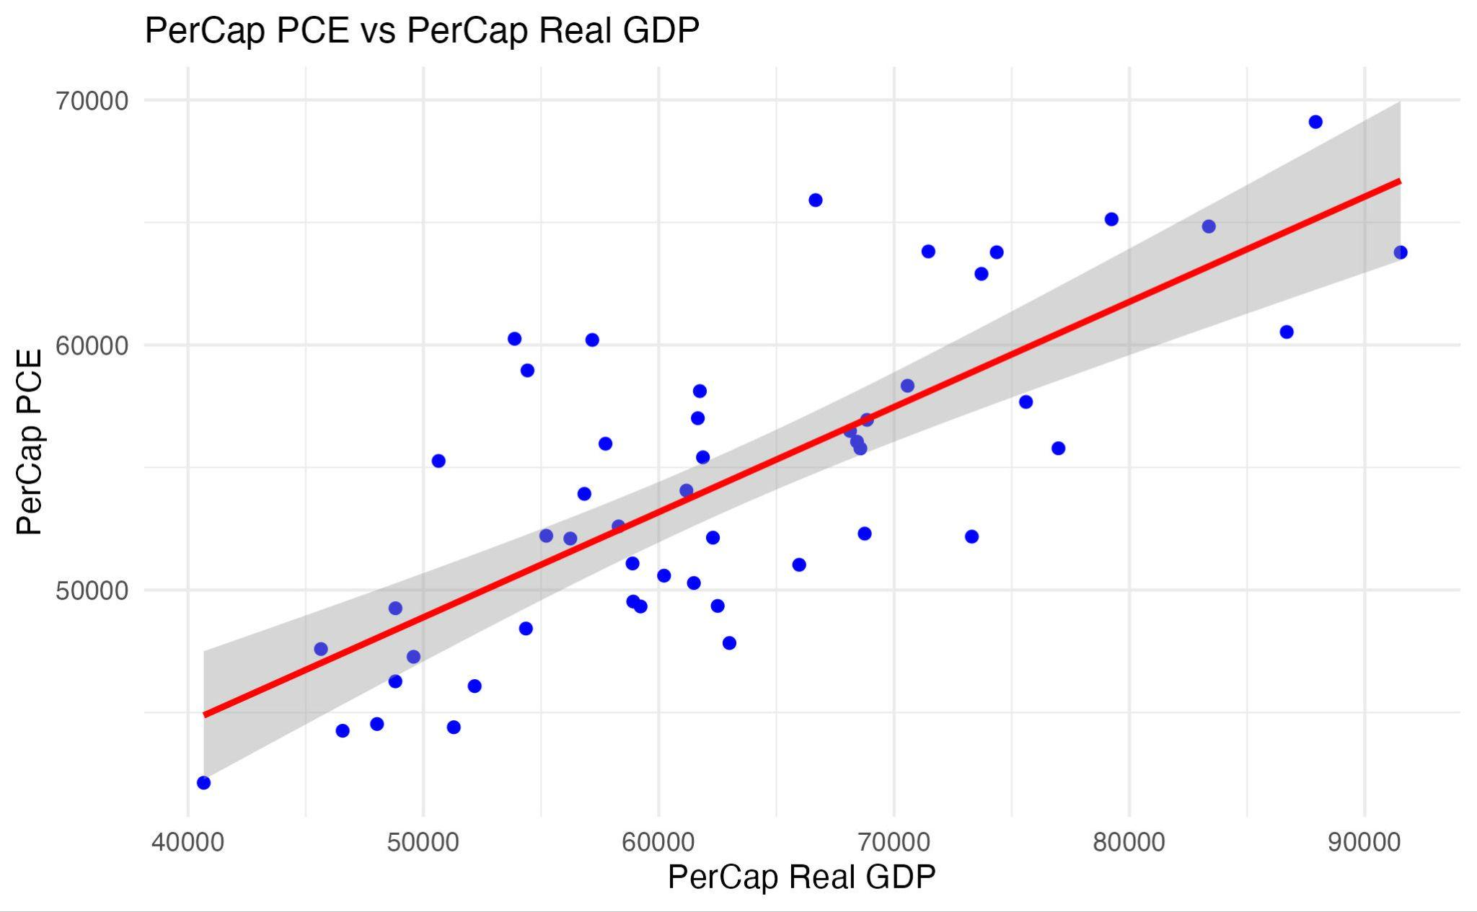
Visualization – Linear Model
Predictor
PerCap Real GDP (40,000 to 91,000)
（Per Capita Real Gross Domistic Product)
Response
PerCap PCE
（Per Capita Consumption Expenditures)
Conclusion
Positive correlation
As economic growth increases, PerCap PCE also tends to increase

Slide 5
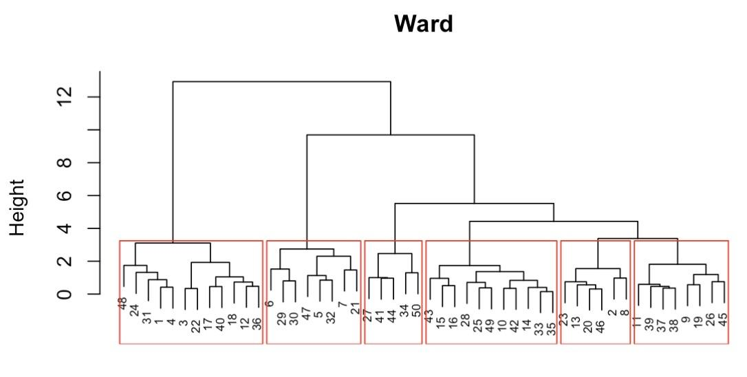
Visualization – Clustering
Dendrogram
Hierarchical clustering
(based on economic indicators)
States grouped into clusters
(highlighted by red boxes)
Clustered States Map
Geographical Distribution
(colored by their respective clusters)
Each color corresponds to the clusters identified in the dendrogram

